Slide 1
113 Final Exam Pool Memorize artist’s name and image date

Slide 2
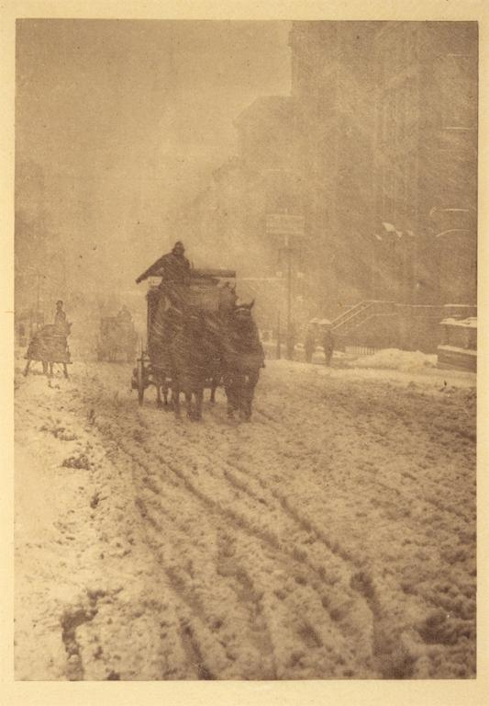
Notes:
Creator: Alfred Stieglitz (American, 1864-1946) Title: Winter - Fifth Avenue Date: 1893 Material: Photogravure

Slide 3
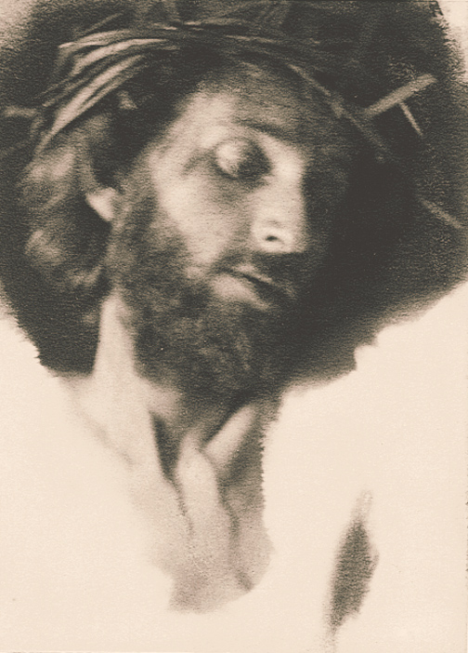
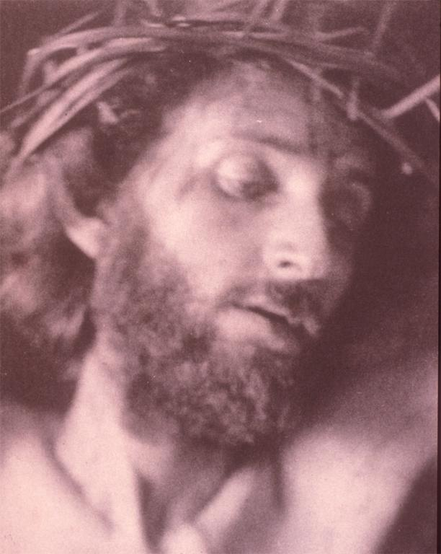
Notes:
Creator: Frederick Holland Day (American, 1864-1933) Title: The Seven Last Words of Christ; "Woman Behold Thy Son, Son Thy Mother” material: platinum print; hotograph Date: 1898

Slide 4
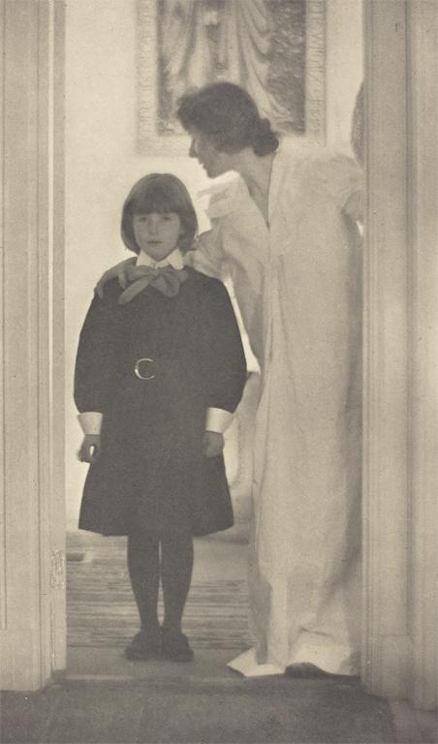
Notes:
Creator: Gertrude Käsebier Title: Blessed Art Thou Among Women Date: c.1900 Material: photogravure

Slide 5
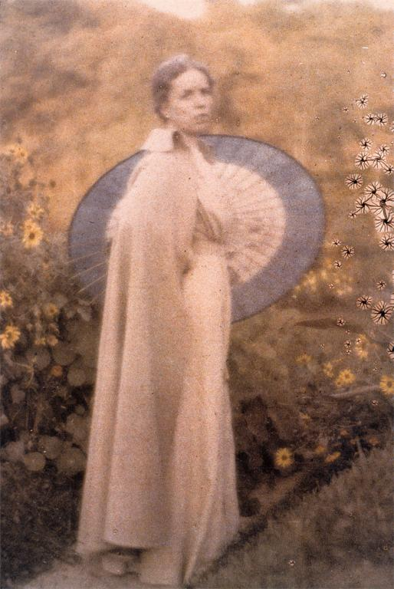
Notes:
Creator: Clarence H. White (American, 1871-1925) Title: Jane Felix White with Japanese umbrella Work Type: autochrome Date: c. 1909 Material: autochrome process

Slide 6
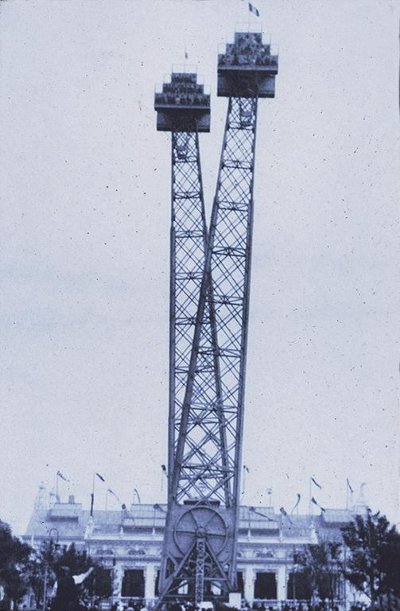
Notes:
Creator: Alvin L. Coburn, 1882-1966 Title: Flip Flap Date: 1908 Material: gelatin silver print

Slide 7
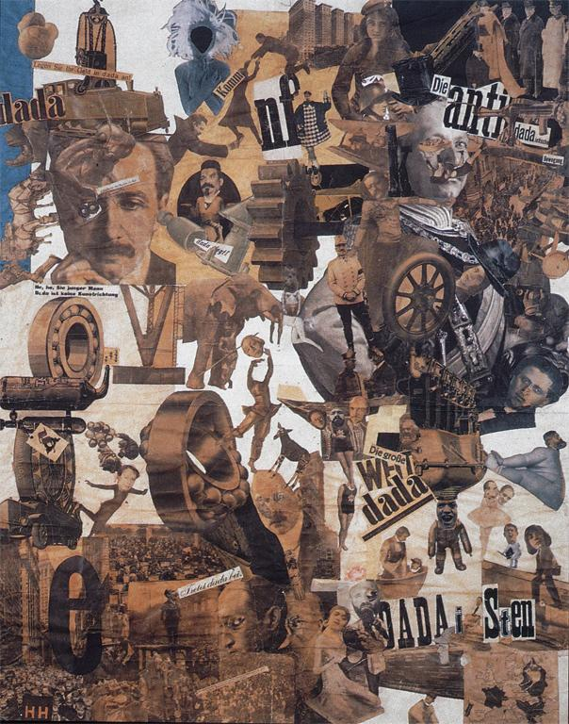
Notes:
Creator: Hannah Hoch (German) Title: Cut with the Kitchen Knife Dada through the Last Weimar Beer-Belly Cultural Epoch of Germany material: photocollage Date: 1919

Slide 8
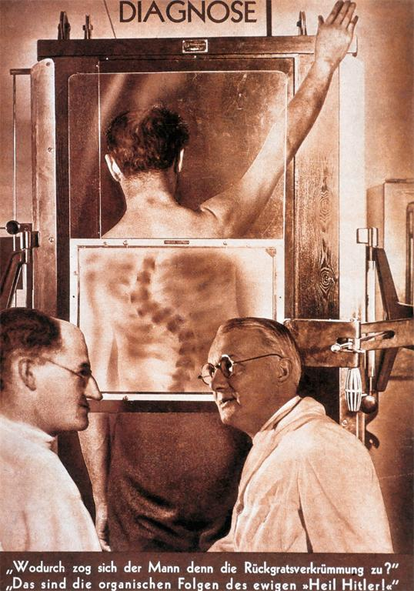
Notes:
Creator: John Heartfield (German, 1891-1968) Title: Diagnosis "What brought about this spinal deformation?" "That's the organic effect of the perpetual 'Heil Hitler!'" material: photomechanical print Date: 1935

Slide 9
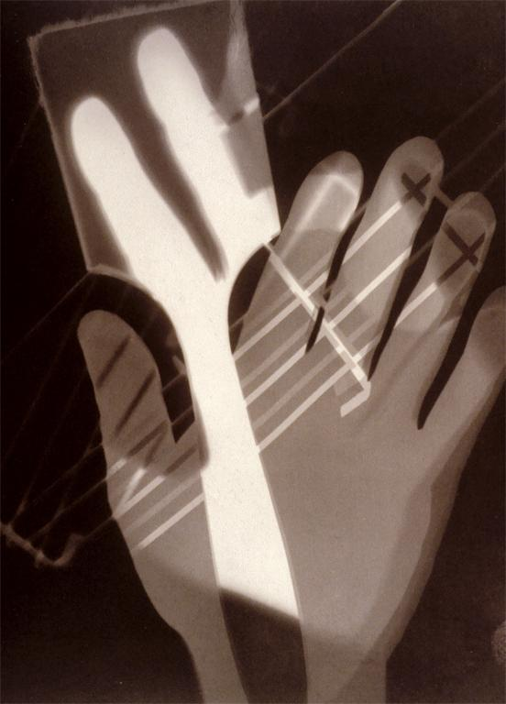
Notes:
Creator: László Moholy-Nagy (American, 1894-1946) Title: Photogram Date: 1926 Material: photogram, gelatin silver

Slide 10
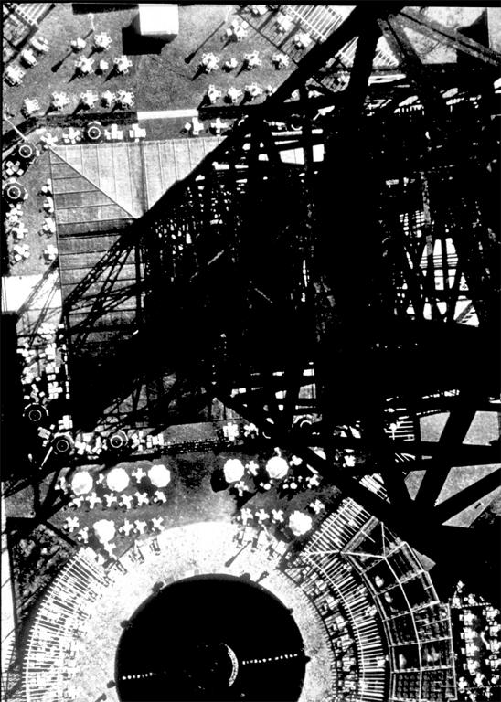
Notes:
Creator: László Moholy-Nagy (American, 1894-1946) Title: From the Radio Tower, Berlin Date: 1928 Material: gelatin silver photograph

Slide 11
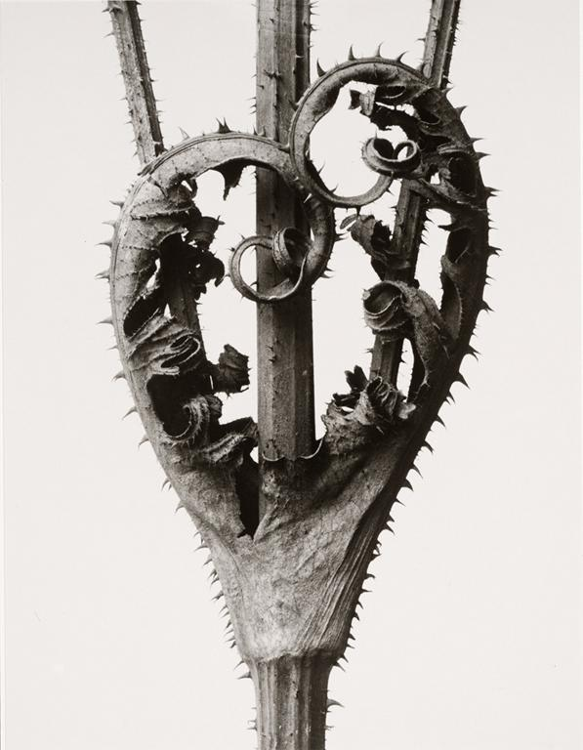
Notes:
Creator: Karl Blossfeldt Title: Dipsacus laciniatus. Date: c. 1900 Material: Gelatin silver print

Slide 12
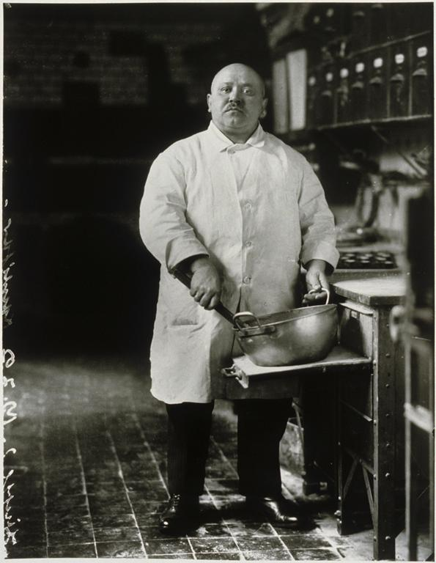
Notes:
Creator: August Sander (German, 1876-1964) Title: Pastry Cook Date: 1928 Material: Gelatin silver print

Slide 13
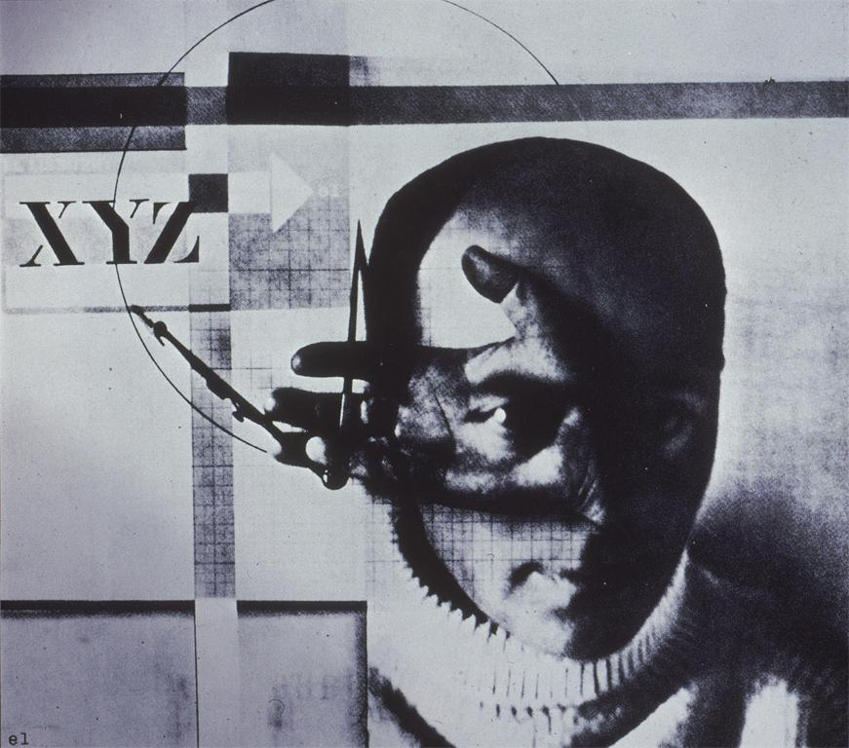
Notes:
Creator: El Lissitzky (Russian/Soviet) Title: The Constructor, Self- Portrait Date: 1924 Material: photomontage

Slide 14
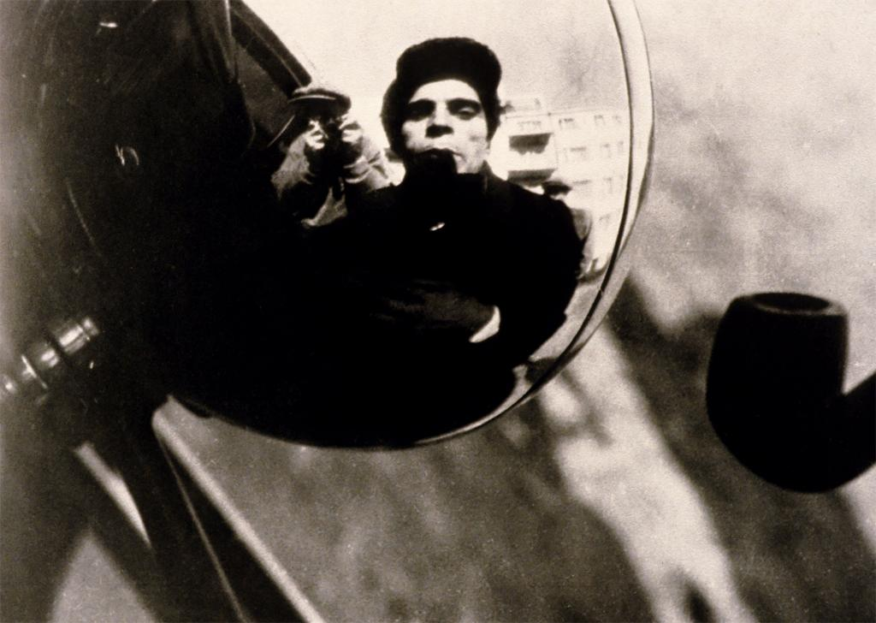
Notes:
Creator: Alexander Rodchenko (Russian, 1891-1956) Title: Driver Date: 1933 Material: gelatin silver process

Slide 15
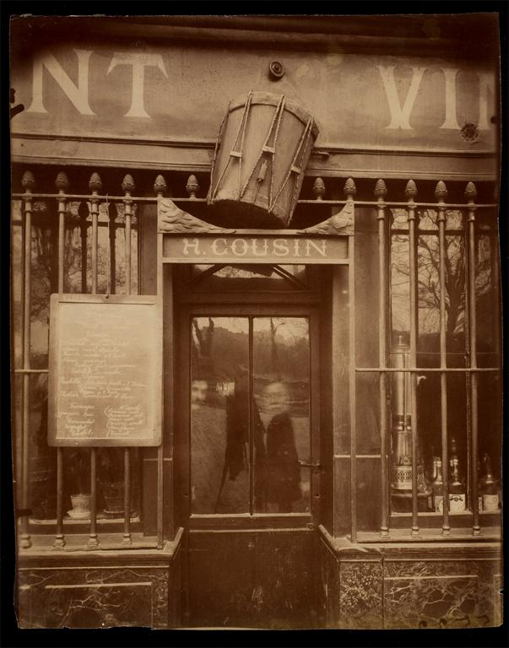
Notes:
Creator: Eugène Atget (French, 1857-1927) Title: Café Au Tambour, 63 quai de la Tournelle (5e arr) Date: 1908

Slide 16
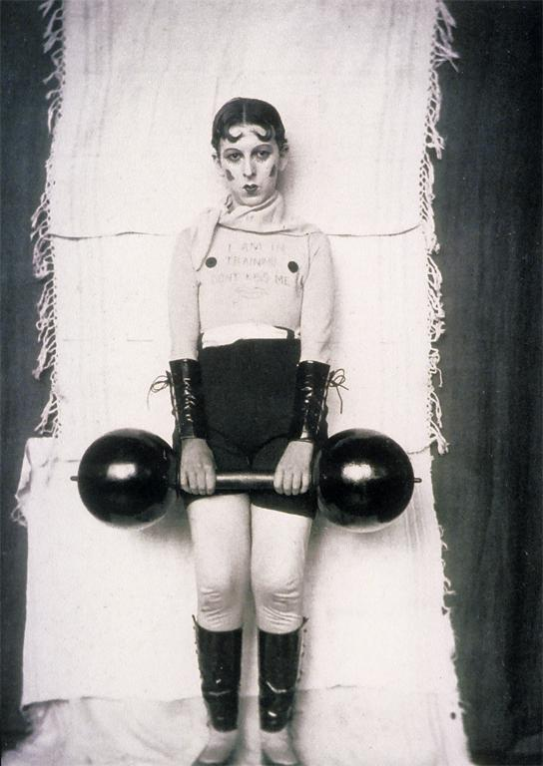
Notes:
Creator: Claude Cahun (French, 1874-1954) Title: Self-Portrait (Don’t Kiss Me, I am In Training Date: 1927 Material: gelatin silver process, photography

Slide 17
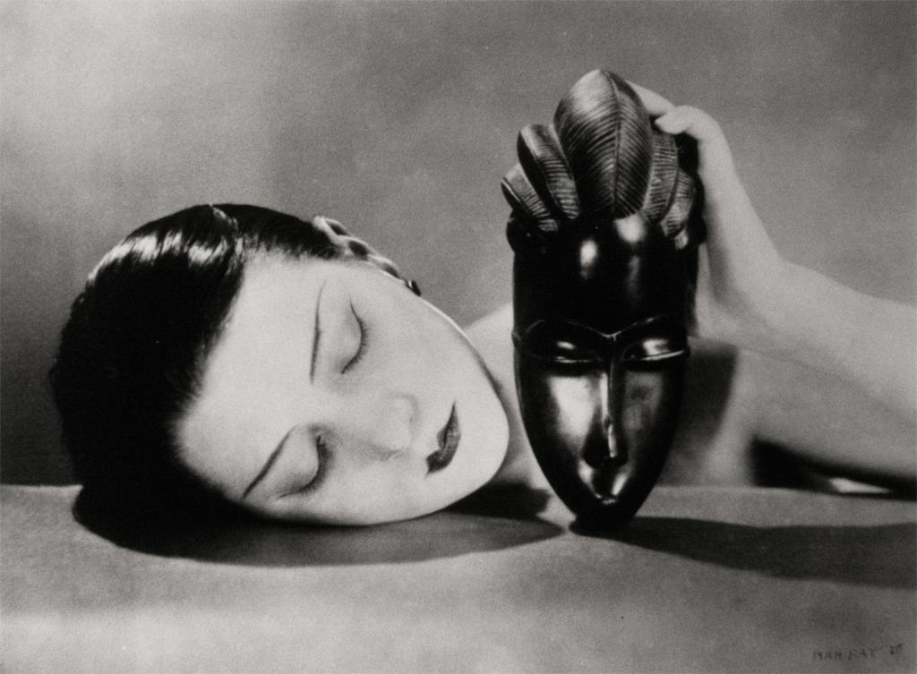
Notes:
Creator: Man Ray (American) Title: Black and White Date: 1926 Material: gelatin silver print

Slide 18
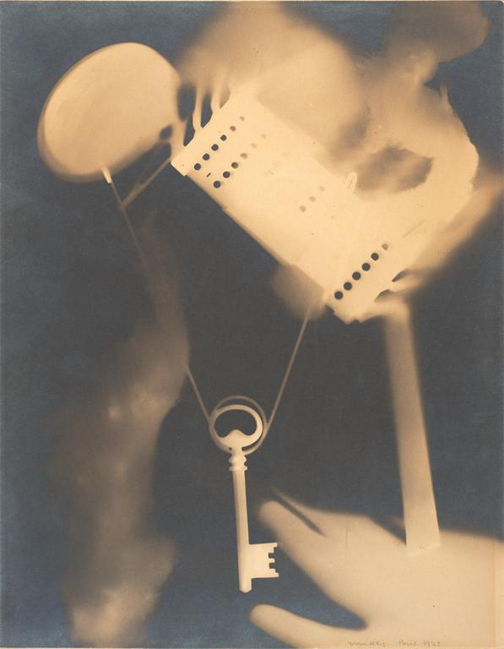
Notes:
Creator: Man Ray (American) Title: Untitled (Rayograph) Date: 1922 Material: gelatin silver print, photogram

Slide 19
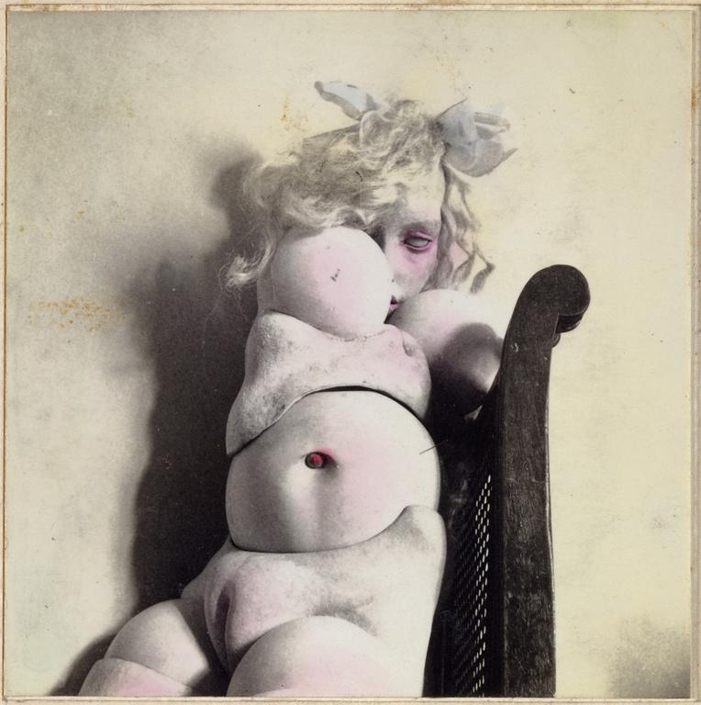
Notes:
Creator: Hans Bellmer (German) Title: The Games of the Doll (Les Jeux de la Poupée) Date: 1938-49 Material: gelatin silver print, hand-colored

Slide 20
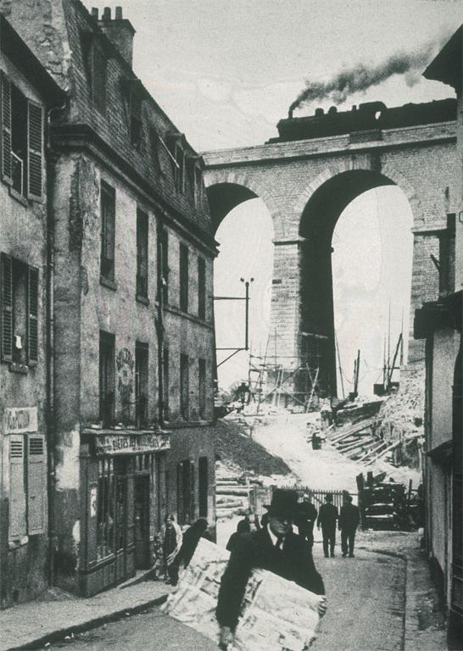
Notes:
Creator: André Kertész Title: Meudon Date: 1928 material: gelatin silver print

Slide 21
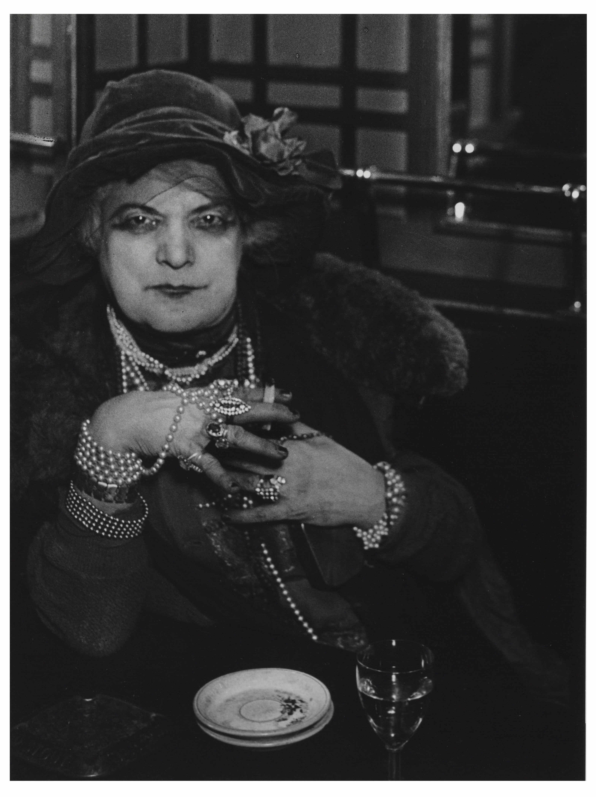
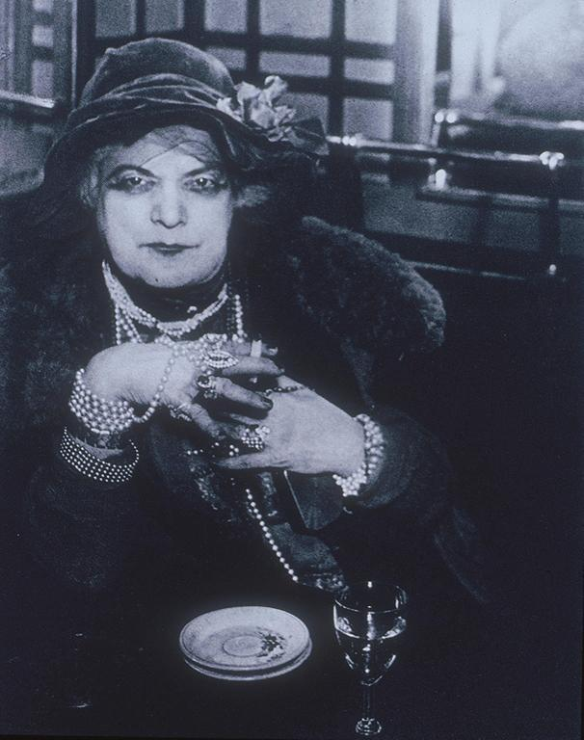
Notes:
Creator: Brassai (born Gyula Halász, Hungarian/French) Title: Bijou, Paris Date: 1933 Material: gelatin silver print

Slide 22
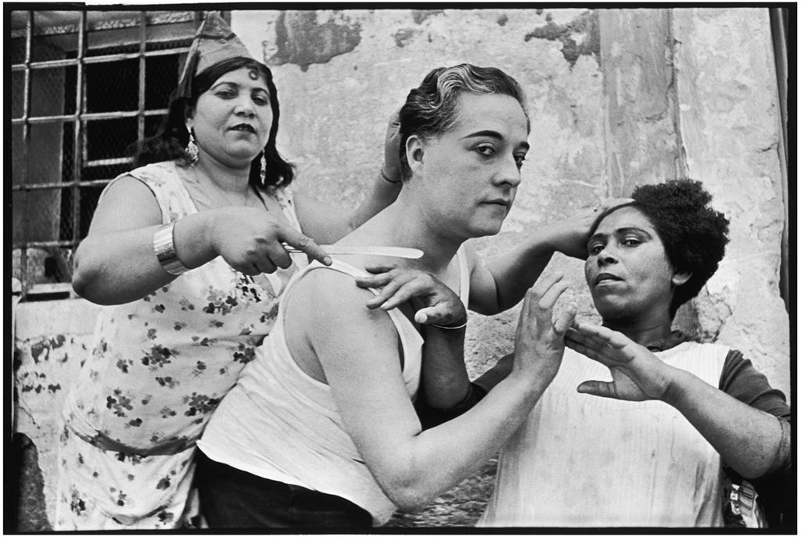
Notes:
Creator: Henri Cartier-Bresson Title: Alicante, Spain 1933. Date: 1933 Material: gelatin silver print

Slide 23
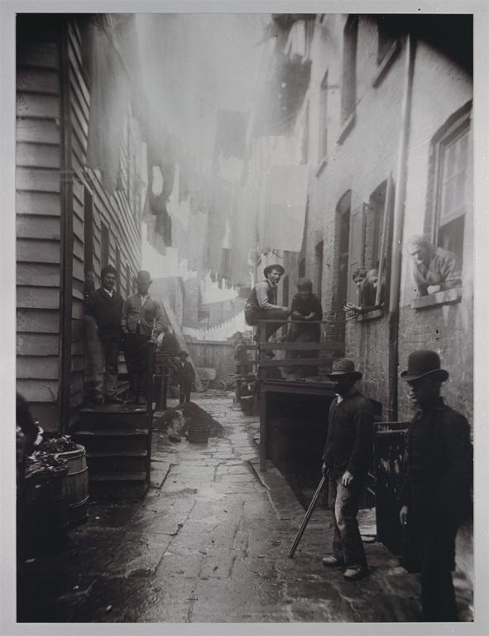
Notes:
Creator: Jacob A. Riis Title: Bandit's roost: 59 1/2 Mulberry Street, New York, New York. Date: 1888. material: photography

Slide 24
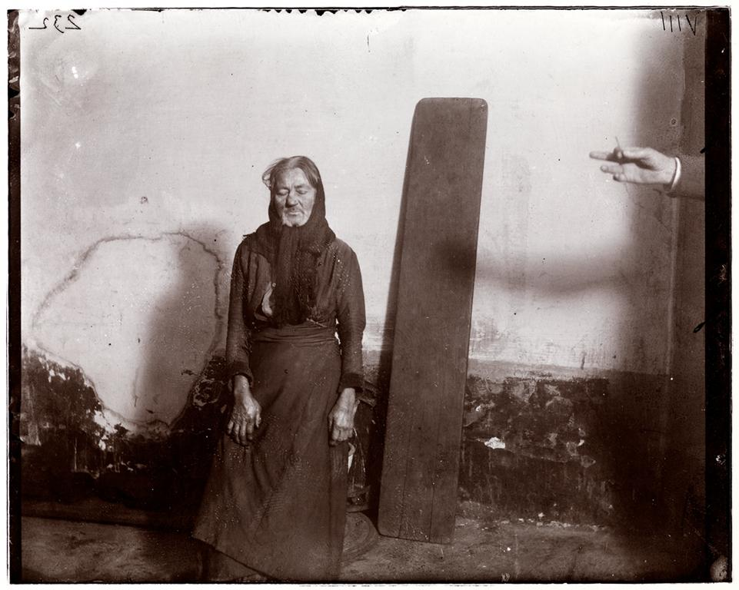
Notes:
Creator: Jacob A. Riis (1849-1914) Title: Police Station Lodgers 8. An ancient women lodger in Eldridge Street Station. Date: 1890 material: gelatin silver photograph

Slide 25
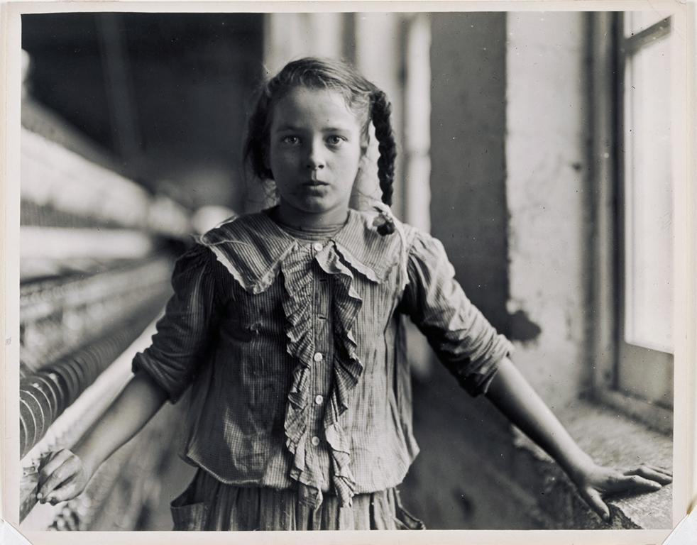
Notes:
Creator: Lewis W. Hine Title: Adolescent Girl, a Spinner, in a Carolina Cotton Mill Date: 1908 Material: Gelatin silver print

Slide 26
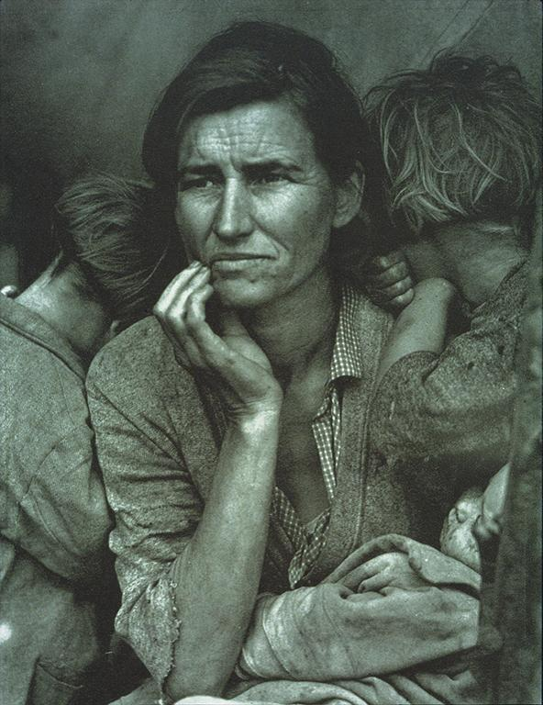
Notes:
Creator: Dorothea Lange Title: Migrant Mother 5, Nipomo, CA Date: 1936 material: gelatin silver print photograph

Slide 27
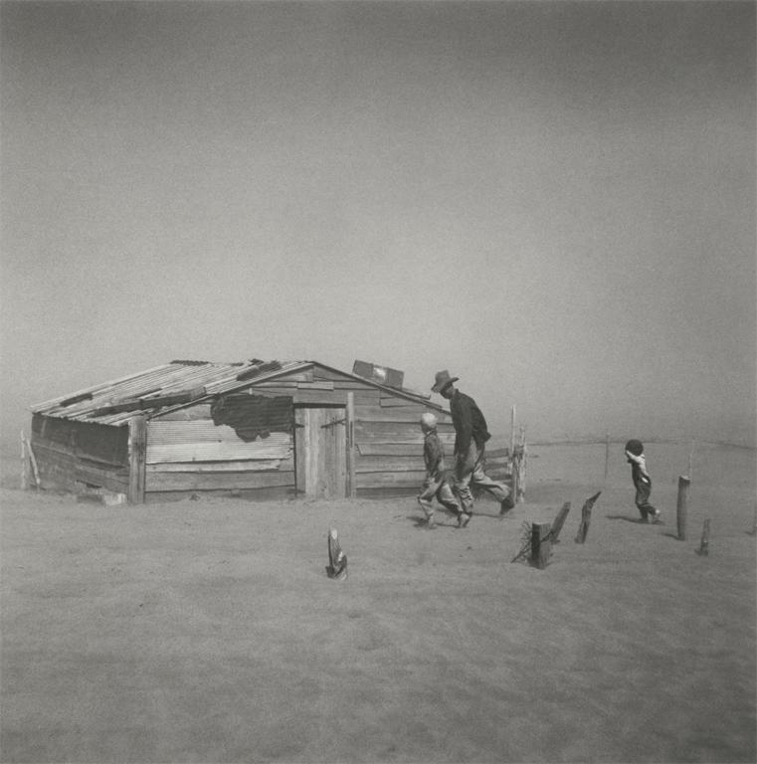
Notes:
Creator: Arthur Rothstein Title: Farmer and Sons Walking in Dust Storm, Cimarron County, Oklahoma Date: 1936 Material: Gelatin silver print

Slide 28
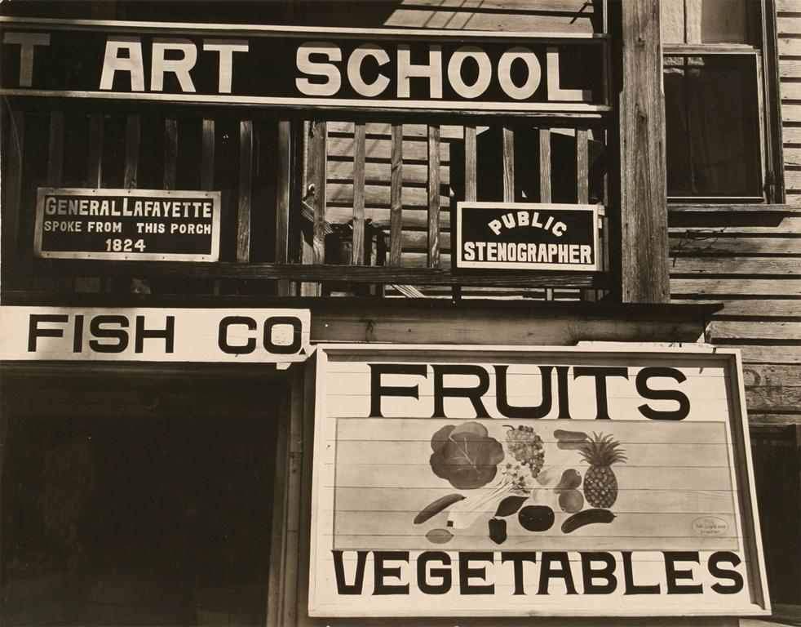
Notes:
Creator: Walker Evans, American Title: Storefront and Signs, Beaufort, South Carolina Date: 1936 Material: gelatin silver print

Slide 29
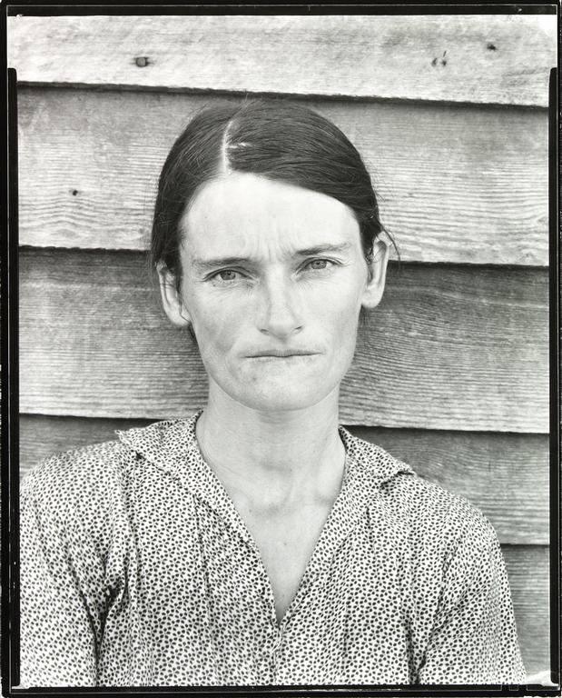
Notes:
Creator: Walker Evans, (American) Title: Allie Mae Burroughs, Wife of a Cotton Sharecropper, Hale County, Alabama Date: 1936 Material: gelatin silver print

Slide 30
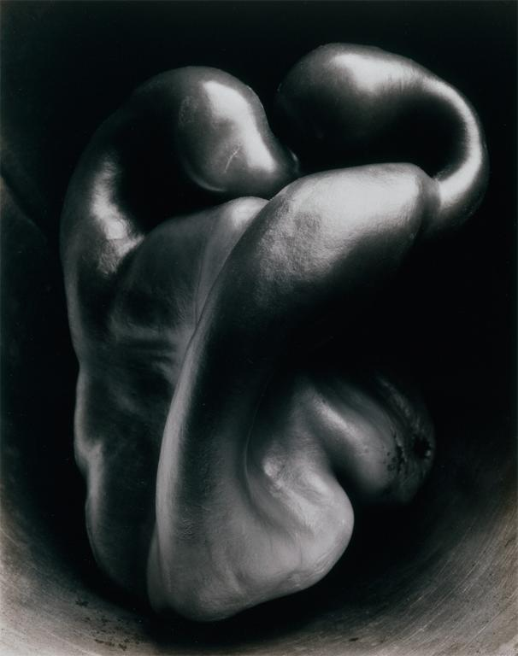
Notes:
Creator: Weston, Edward (American, 1886-1958) Title: Pepper No. 30 Date: 1930 Material: Gelatin silver print

Slide 31
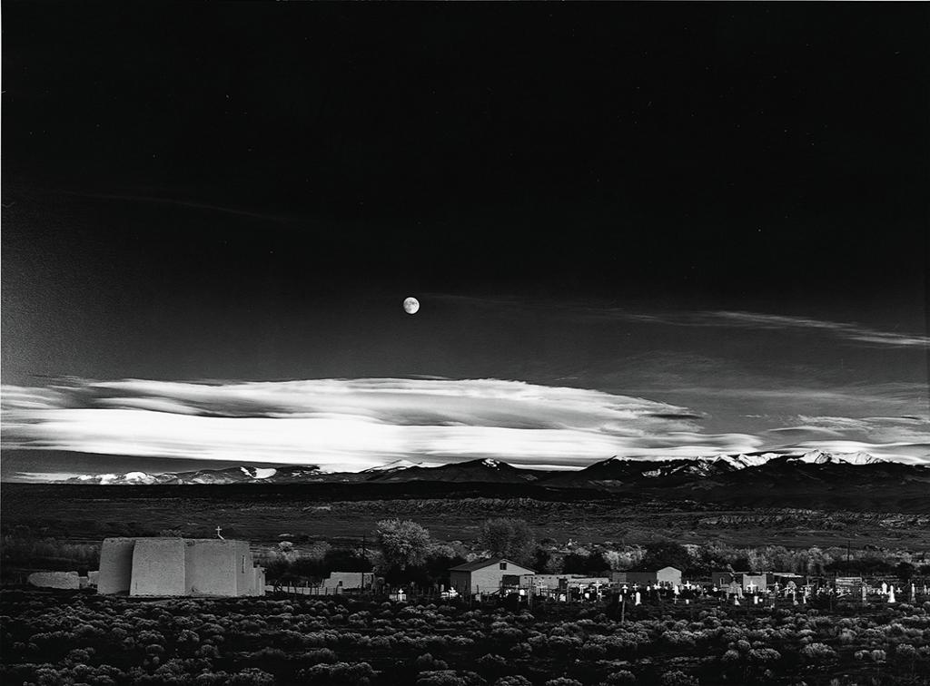
Notes:
Creator: Ansel Adams (American) Title: Moonrise, Hernandez, New Mexico 1941 Date: 1941 Material: gelatin silver print

Slide 32
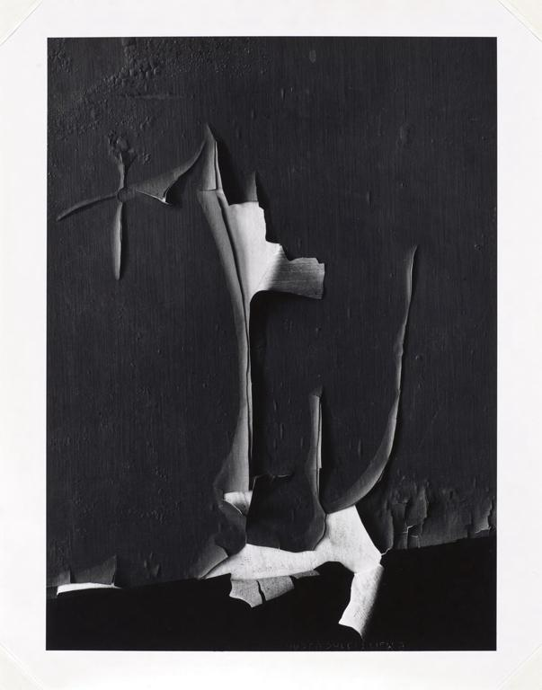
Notes:
Creator: Minor White American (American, 1908-1976) Title: Rochester Date: 1959 Material: Gelatin silver print

Slide 33
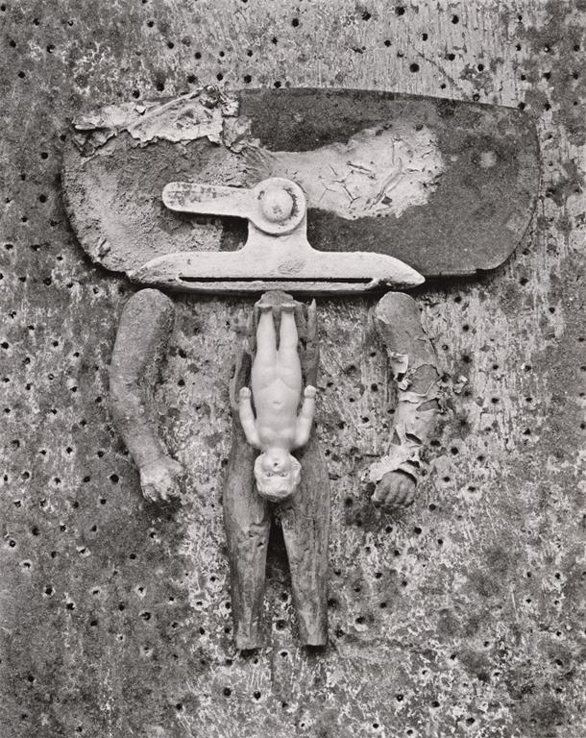
Notes:
Creator: Frederick Sommer Title: Valise d'Adam Date: 1949 Material: Gelatin silver print

Slide 34
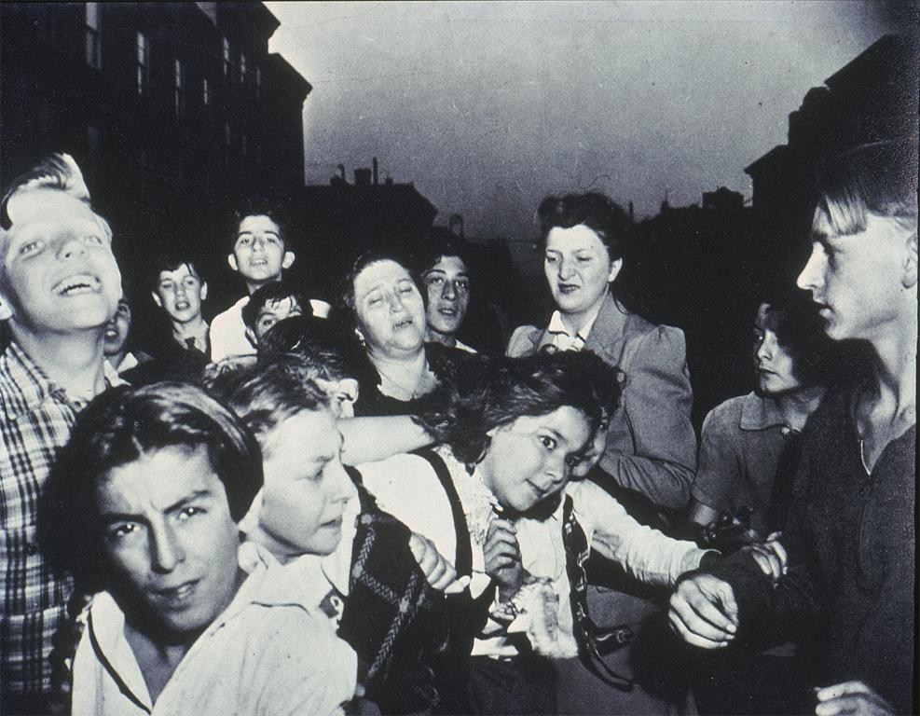
Notes:
Creator: Weegee (American, 1899-1968) Title: Brooklyn Schoolchildren See Gambler Murdered on Street (Their First Murder) Date: 1941 Material: gelatin silver print

Slide 35
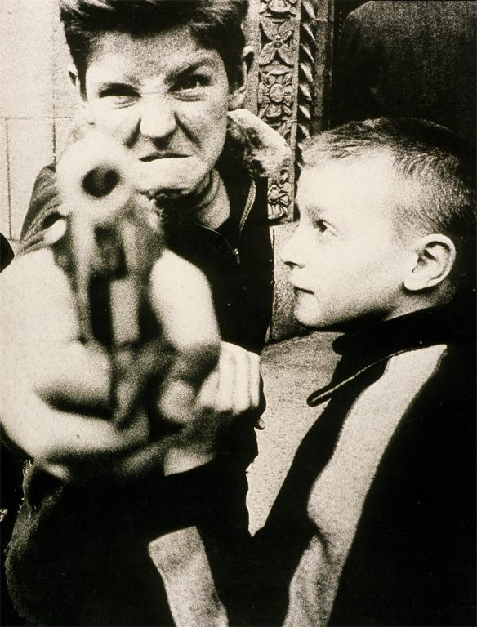
Notes:
Creator: William Klein (American, 1928 - ) Title: Revolver. Broadway and 103rd Street, New York Date: 1954 Material: gelatin silver print

Slide 36
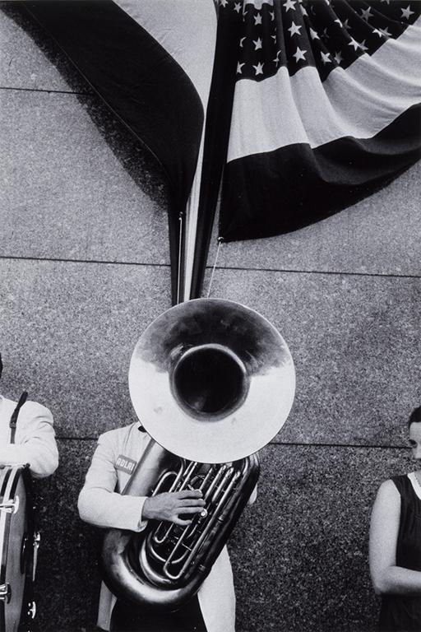
Notes:
Creator: Frank, Robert (American, born Switzerland, 1924-) Title: Political Rally, Chicago from the series The Americans Date: 1956 Material: Gelatin silver print

Slide 37
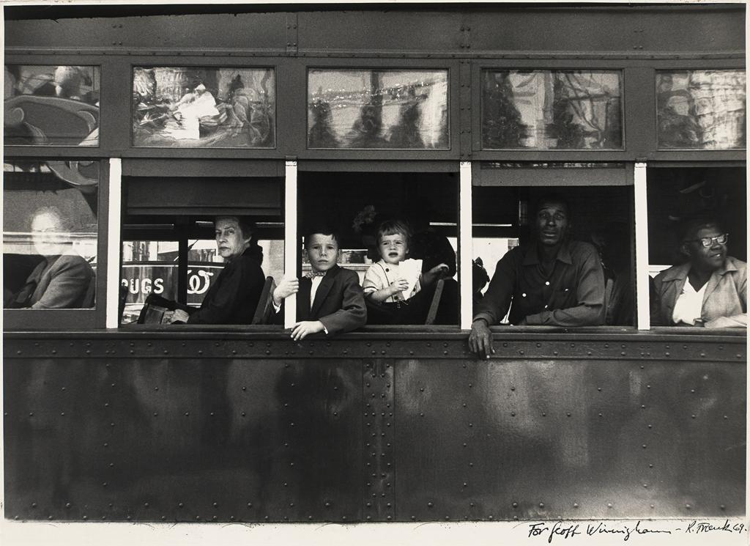
Notes:
Creator: Robert Frank (American, born Switzerland) Title: Trolley, New Orleans Date: 1955 Material: Gelatin silver print

Slide 38
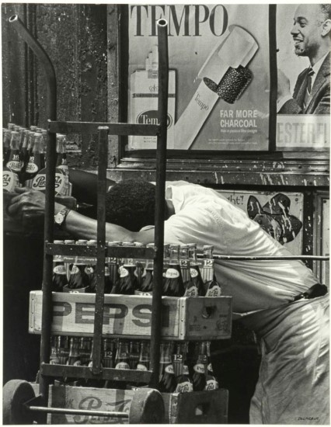
Notes:
Creator: Roy DeCararva (American)
Title: Pepsi
Date: 1964
Material: gelatin silver

Slide 39
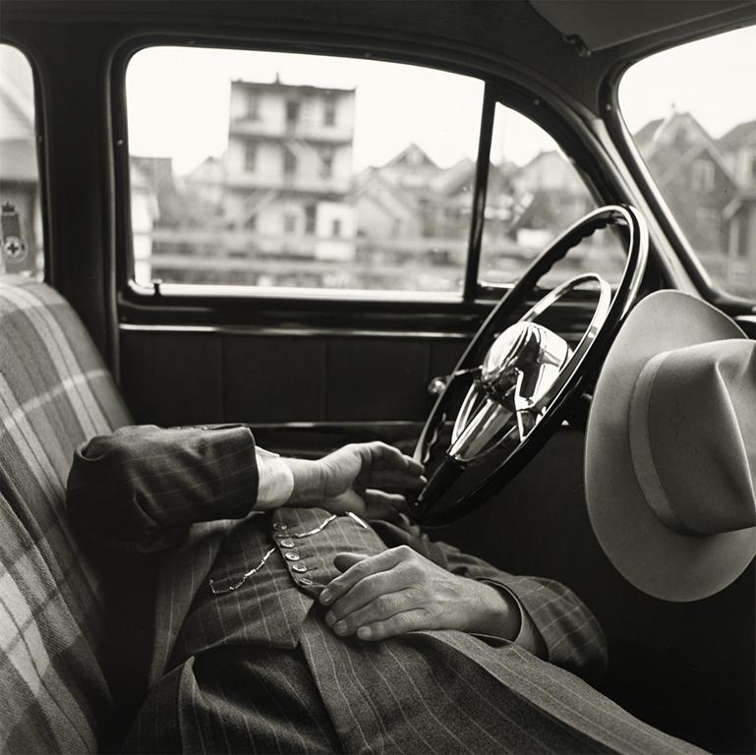
Notes:
Creator: Vivian Maier (American) Title: Untitled Date: c. 1960 Material: Gelatin silver print (printed 2011)

Slide 40
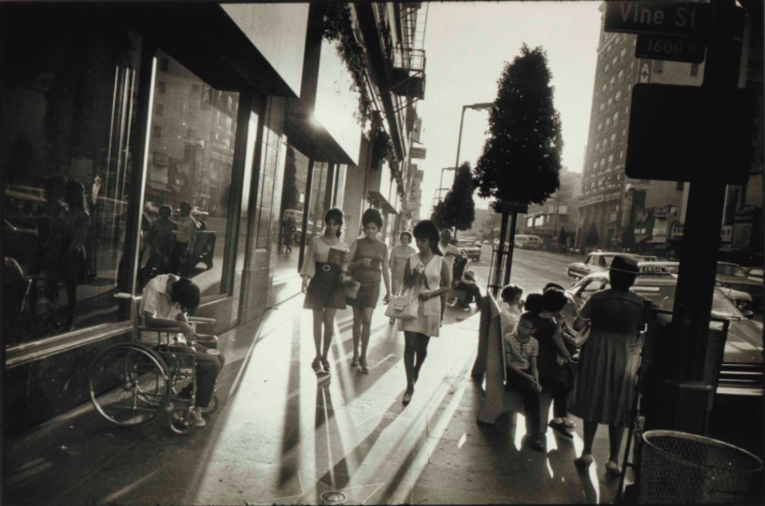
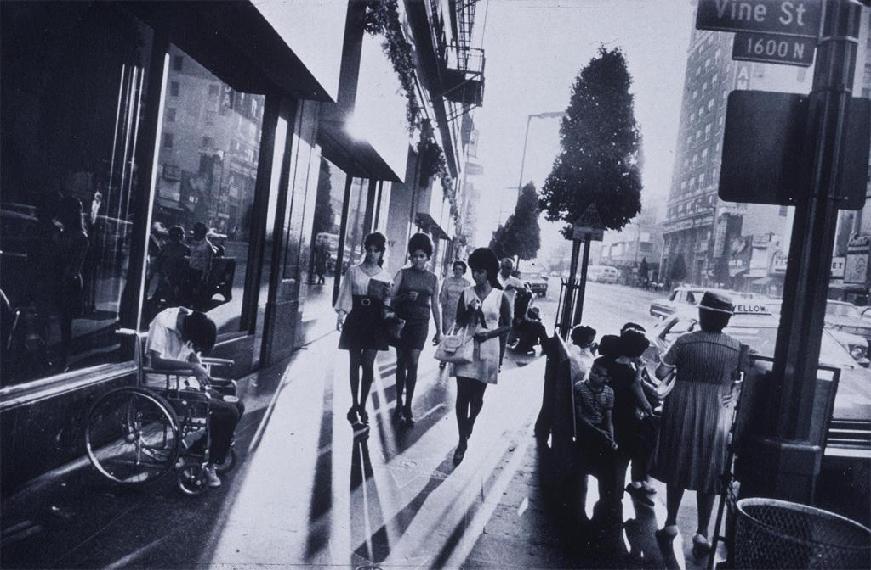
Notes:
Creator: Garry Winogrand Title: Hollywood Blvd., Los Angeles Date: 1969 material: gelatin silver print

Slide 41
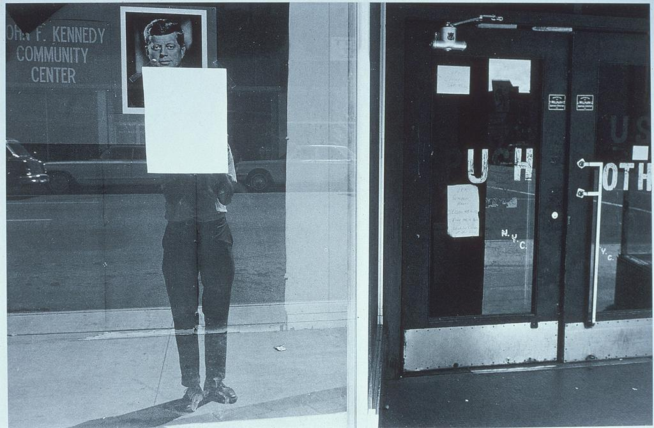
Notes:
Creator: Lee Friedlander Title: Colorado Date: 1967 Material: gelatin silver print

Slide 42
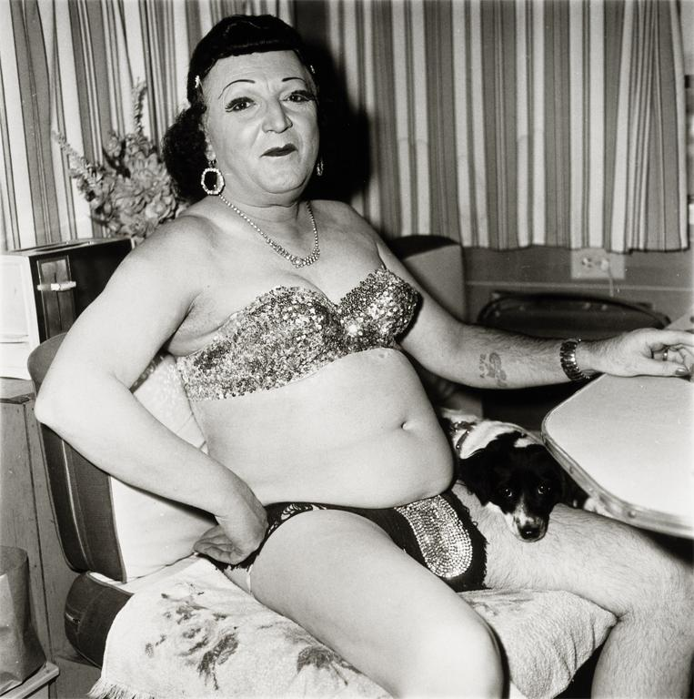
Notes:
Creator: Diane Arbus (American, 1923-1971) Title: Hermaphrodite and Dog in a Carnival Trailer Date: 1970 Material: Gelatin silver print

Slide 43
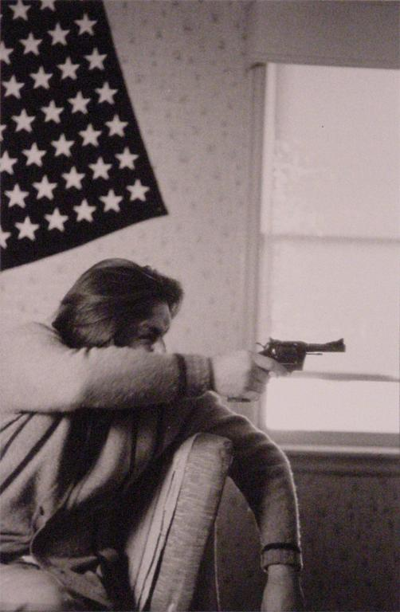
Notes:
Creator: Larry Clark (American) Title: Untitled (from Tulsa, published 1971)
Date: c. 1966 material: gelatin silver print

Slide 44
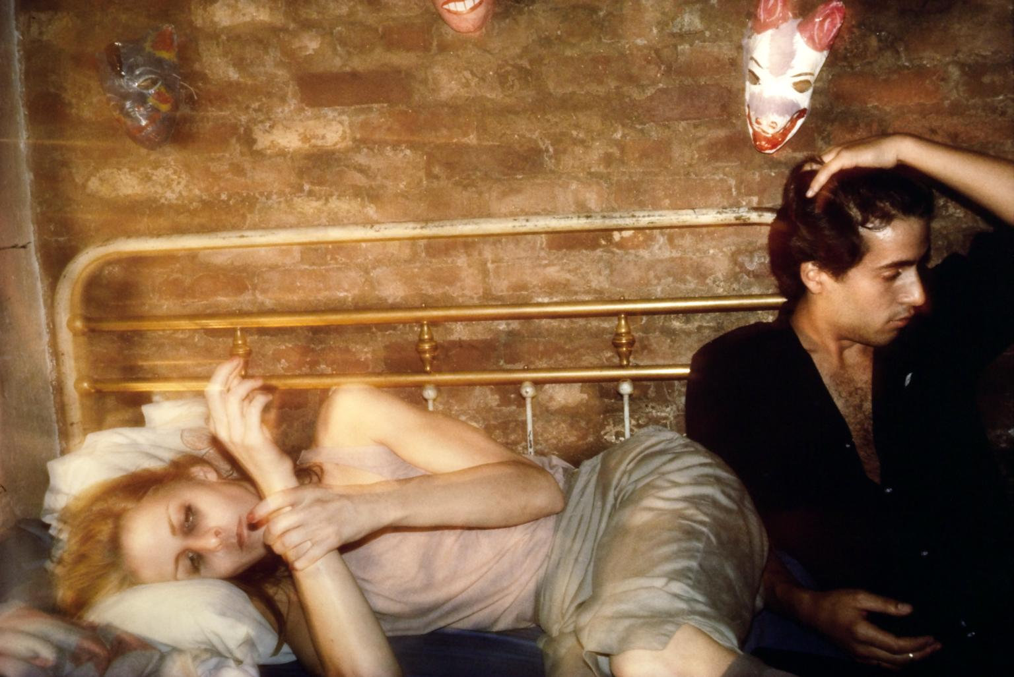
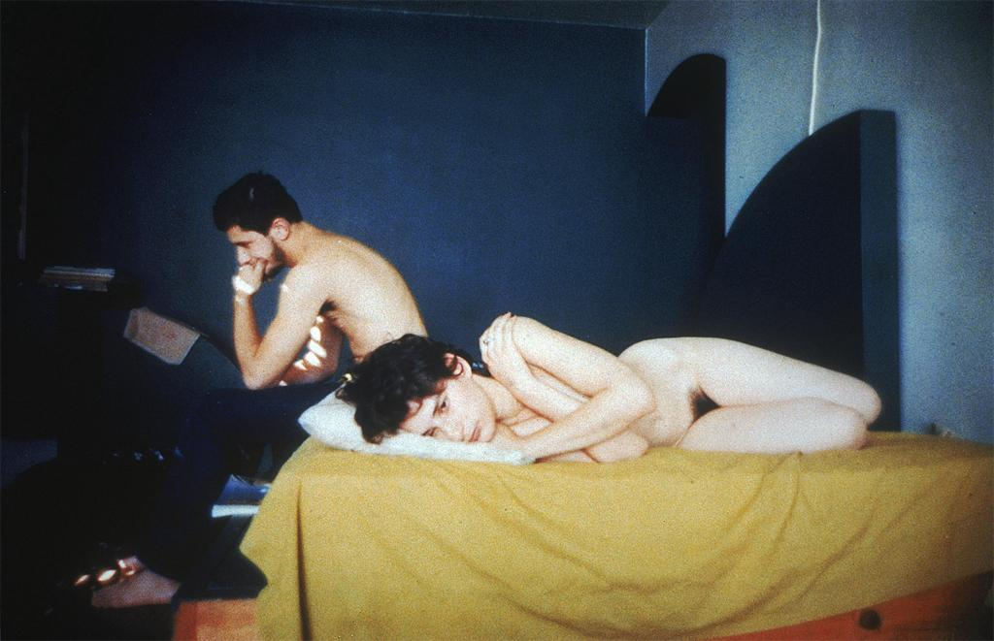
Notes:
Creator: Nan Goldin (American) Title: Greer and Robert on the Bed, from the book, The Ballad of Sexual Dependency Date: 1982
material: cibachrome print

Slide 45
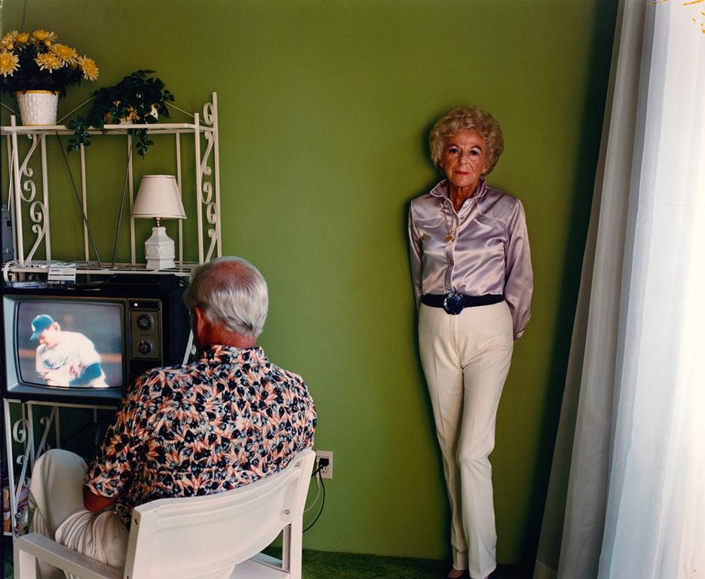
Notes:
Creator: Larry Sultan (American 1946-2009 ) Title: My Mother Posing for Me, from the series Pictures From Home Date: 1984 Material: chromogenic print

Slide 46
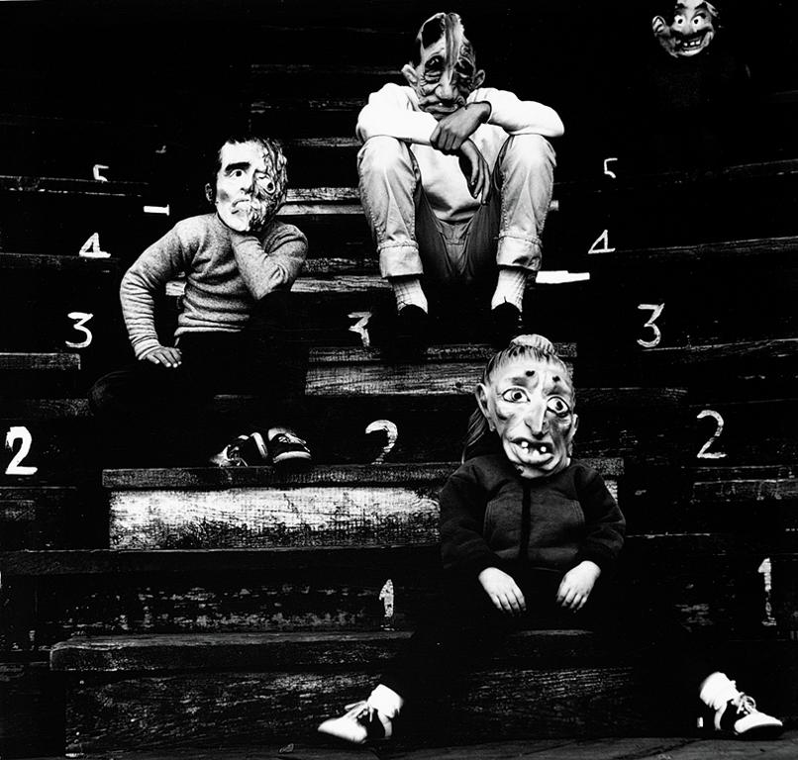
Notes:
Creator: Ralph Eugene Meatyard (American, 1925-1972) Title: Romance (N) from Ambrose Bierce, No. 3 Date: 1962 Material: gelatin silver print

Slide 47
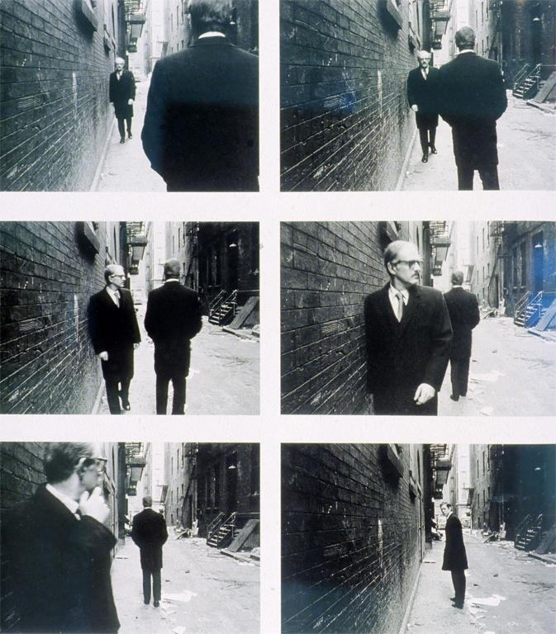
Notes:
Creator: Duane Michals (American, 1932 - ) Title: Chance Meeting Date: 1972 Material: six gelatin silver prints

Slide 48

Notes:
Creator: Lewis Baltz (American) Title: Northwest Wall, Unoccupied Industrial Spaces, 17875 C and D, Skypark Circle, Irving, CA Date: 1974 Material: gelatin silver print

Slide 49

Notes:
Creator: William Eggleston (American, 1939-) Title: Red Ceiling Date: 1973 Material: Dye imbibition print

Slide 50

Notes:
Creator: Stephen Shore Title: U.S. 10, Port Falls, Idaho Date: 1974 material: color chromogenic print

Slide 51

Notes:
Creator: Andy Warhol, (American) Title: Marilyn Monroe Date: 1962 material: photosilkscreen

Slide 52

Notes:
Creator: Robert Heinecken (American, 1931-2006) Title: Untitled Periodicals (This is the way love is in 1970) Date: 1971 Material: offset lithography on magazine page

Slide 53

Notes:
Creator: Martha Rosler (American, 1943-) Title: Cleaning the Drapes
Date: c. 1970 Material: photomontage

Slide 54

Notes:
Creator: John Baldessari (American, 1931 - ) Title: Heel Date: 1986 Material: photographs, oil stick, acrylic paint

Slide 55

Notes:
Creator: Cindy Sherman Title: Untitled Film Still #14 Date: 1978 Material: gelatin silver print

Slide 56

Notes:
Creator: Cindy Sherman (American, 1954 - ) Title: Untitled #96 (Centerfold Series) Date: 1981 Material: chromogenic color print

Slide 57

Notes:
Creatorr: Richard Prince (American, 1949 - ) Title: Untitled (Cowboy) Date: 1988 Material: Ektachrome (TM) Measurements: 40x60 inches

Slide 58

Notes:
Creator: Barbara Kruger (American, 1945 - ) Title: Untitled [When I hear the word Culture I take out my Checkbook] date: 1985 Material: three gelatin silver prints

Slide 59

Notes:
Creator: Lorna Simpson (America) Title: Untitled (Two Necklines) Date: 1989 Material: two gelatin silver prints and 11 engraved plastic plaques

Slide 60

Notes:
Creator: Jeff Wall (Canadian artist, 1946-) Title: Mimic Date: 1982 Material: Cibachrome transparency in a lightbox

Slide 61

Notes:
Creator: Andreas Gursky (German) Title: 99 cent Date: 1999 Material: chromogenic print Measurements: 81 ½ c 132 ½ inches

Slide 62

Notes:
Creator: Orozco, Gabriel (Mexican) Title: Cats and Watermelons Date: 1992 Material: cibachrome photograph

Slide 63

Notes:
Creator: Mike Mandel and Larry Sultan Title: (appropriated photograph from the book Evidence) Date: 1977 material: gelatin silver print

Slide 64

Notes:
Creator: Taryn Simon (American)
Title: Cryopreservation Unit, Cryonics Institute, Clinton Township, MI (From the series An American Index of the Hidden and Unfamiliar)
Date: 2007
Material: archival inkjet print

Slide 65

Notes:
Creator: Yinka Shonibare (British-Nigerian) Title: Diary of a Victorian Dandy: 19.00 Hours Date: 1998 Material: chromogenic print Measurements: 78 1/2" x 96”

Slide 66

Notes:
Creator: Carrie Mae Weems (American)
Title: The Assassination of Medger, Malcolm, and Martin, from the series Constructing History
Date: 2008
Material: archival pigment print

